Slide 1
HWPE: A CNN Accelerator for RISC-V
Author: Hao Chen , Qiang Chen
chenhaocxjtu@163.com
chenqiang5233@hotmail.com
Notes:
Hello everyone. I'm xx
Today, I'm honored to be here to introduce a coprocessor for you. It's a CNN accelerator for RISC-V which is called HWPE.

Slide 2
What can HWPE do?
HWPE（CNN Hardware Processing Engines）
A CNN hardware acceleration coprocessor for RISC-V
Support Convolution layer and ReLU layer
Transform convolution into matrix multiplication (im2col on the fly)
Kernel size from 3×3 to 11×11
Support data type int8(uint8), exp4 (4 bits of exponential scale) and ternary
16 dot-product operations of 64 bits operands(8 int8, 16 exp4 or 32 ternary) per cycle
Complete a convolution layer operation with one configuration
Notes:
So What is HWPE? The full name is the CNN hardware processing engine. it is based on RISC-V extended instruction set. The HWPE supports the acceleration for convolution layer and ReLU layer. The main job of HWPE is transforming convolution into matrix multiplication. HWPE supports kernel size from 3x3 to 11x11, and data type 8 bits signed/unsigned integer, 4 bits exponential scale, and 2 bits ternary. You can use HWPE to complete a convolution layer with one configuration.

Slide 3
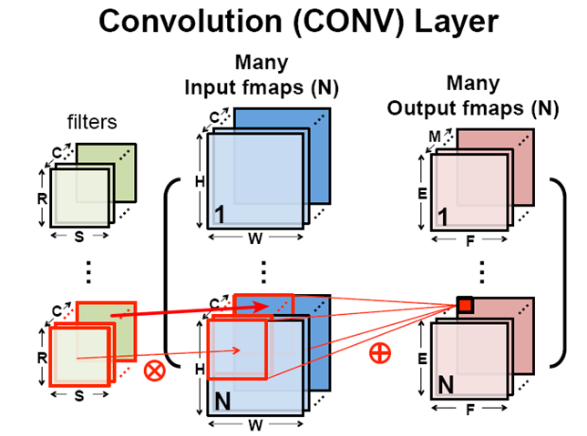
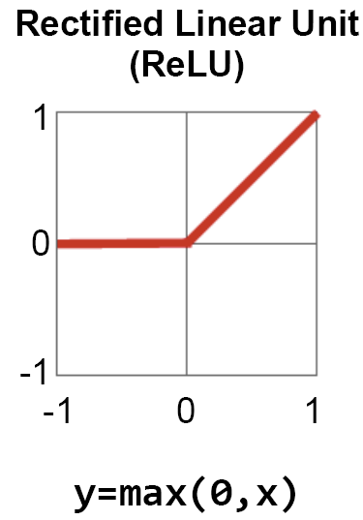
Convolution & ReLU
Fully-Connected layer and pooling layer are still calculated by MCU
Notes:
This picture shows the convolution and ReLU operations. these two layer are the target of the acceleration. As for Fully-Connected layer and pooling layer, they are still processed by MCU.

Slide 4
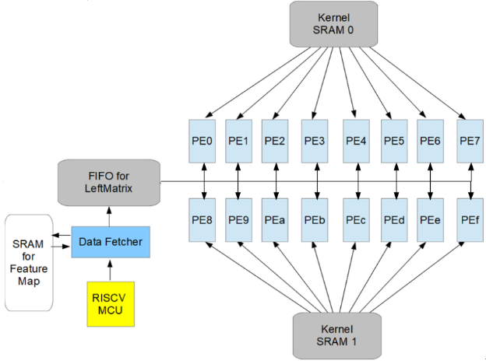
Architecture Diagram
Data fetcher accepts the command from MCU and fetches data from Feature Map SRAM and pushes them into FIFO in the way of im2col
FIFO is used as a buffer for the left matrix
16 PE, each one stores a 64 bits right matrix, performs multiply-accumulate and stores a column result matrix
Two kernel SRAMs, each one broadcasts the data of the right matrix to 8 PE
Notes:
This is the architecture diagram of HWPE. It has several parts. Data fetcher accepts the command from RISC-V MCU and fetches data from input Feature Map SRAM and pushes them into FIFO in the way of im2col. So, the FIFO is used as a buffer for the left matrix. There are 16 processing element, each one stores a 64 bits right matrix, performs multiply-accumulate and stores a column result matrix. There are two kernel SRAMs, each one broadcasts the data of the right matrix to 8 PE.

Slide 5
Convolution / Matrix Multiplication
Transform convolution into matrix multiplication
Left Matrix : data-fetcher calculate memory address to access data in the way of im2col
Right Matrix : store the kernel in the way of channel priority in advance
Notes:
HWPE will transform convolution into matrix multiplication. How to realize the transformation? The data-fetcher calculate memory address to access data in the way of im2col, so we get the left matrix by accessing memory in the specified order. However, the kernels are parameters that have been trained and prepared. So we can store the right matrix in advance.

Slide 6
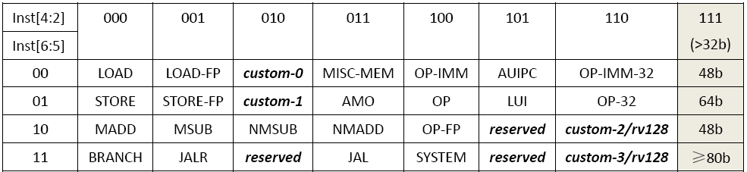
HWPE Instructions
HWPE has only 7 instructions based on custom-0 opcode of RISC-V extended instruction set
RISC-V basic opcode mapping table
HWPE Instructions table
Instruction | funct | rd | xd | rs1 | xs1 | rs2 | xs2
HWPEWriteFmapAddrReg | 1 | addr_idx | 0 | addr1 | 1 | addr2 | 1
HWPEWriteCfgReg | 2 | —— | 0 | cfg | 1 | cfg | 1
HWPEMatrixMac | 4 | —— | 0 | W/H_count | 1 | H/W_stride | 1
HWPEWriteAccReg | 8 | AccReg_ID | 0 | M(idx) | 1 | PE_ID | 0
HWPEReadAccReg | 16 | M(idx) | 1 | Acc_Reg_ID | 0 | PE_ID | 0
HWPEReLUMemWriteAccReg | 32 | —— | 0 | M(addr) | 1 | AccReg_ID | 0
HWPEReset | 64 | —— | 0 | —— | 0 | —— | 0
Notes:
The instructions of HWPE are based on custom-0 opcode of RISC-V extended instruction set. Actually HWPE has only 7 coprocessor instructions. Lets see what we can do with these 7 instructions.

Slide 7
What do HWPE Instructions do?
1 | HWPEReset | perform a synchronous reset for the HWPE registers
2 | HWPEWriteFmapAddrReg | configure 8 base address registers which point to the 8 initial points of the H-W plane
3 | HWPEWriteCfgReg | configure control registers for convolution
4 | HWPEWriteAccReg | reset or set AccRegs / adds the bias in convolution layers
5 | HWPEMatrixMac | start first round of convolution operation
6 | HWPEReadAccReg | read the AccRegs back to the MCU general registers
7 | HWPEReLUMemWriteAccReg | execute ReLU operation and transfer the 32 bits AccRegs to 8 bits, then store the results into the specified memory address
Notes:
The first instruction is HWPEReset which reset all the registers of HWPE. You have to use this instruction at the begining. Two and Three are 2 instructions that configure configuration registers. HWPEWriteAccReg can reset result registers or add a bias for convolution layer. HWPEMatrixMac will starts the first round of convolution operations. HWPE will process 8 points of the input feature map and 16 different kernels to get 128 output points every round. HWPEReadAccReg reads the results back to the MCU general registers. HWPEReLUMemWriteAccReg execute ReLU operation and transfer the 32 bits AccRegs to 8 bits, then store the results into the specified memory address.

Slide 8
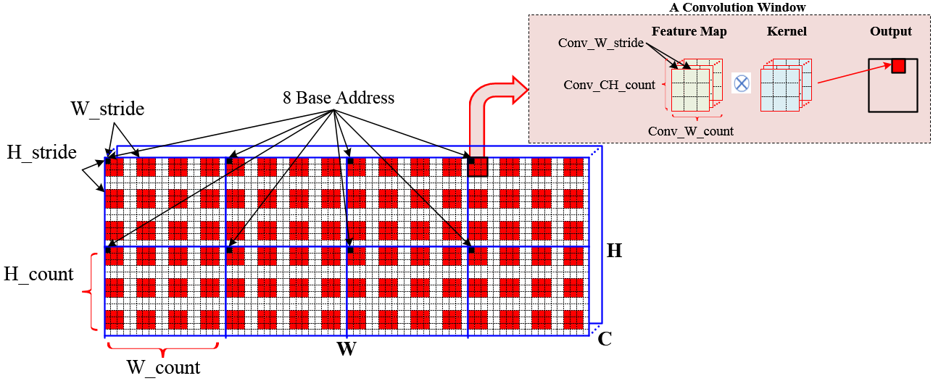
How to run CNN: Config Registers
A convolution task is determined by the configuration registers.
Config Registers:
FmapAddrBase[8]
H_stride
W_stride
H_count
W_count
Conv_W_stride
Kernel_size
Conv_CH_count
Head address of convolution windows:
SRAM memory access address:
FmapConvAddr[i] = FmapAddrBase[i] + x·W_stride + y·H_stride 0≤x≤H_count; 0≤y≤W_count
FmapSramAddr[i] = FmapConvAddr[i] + m·Conv_W_stride + n·Conv_CH_stride
0≤m≤Conv_CH_count; 0≤n≤Kernel_size
Notes:
So, how to run CNN? In our design, a convolution task is determined by the configuration registers. There are some config registers which control the calculation times, memory access address and so on. When these registers are configured, the memory access address can be calculated every cycle.

Slide 9
How to run CNN
Configure the configuration registers with HWPEWriteFmapAddrReg & HWPEWriteCfgReg
select 8 initial points on the H-W plane as base address, each one is the head address in the first convolution window.
Start the first round of convolution operations with HWPEMatrixMac. 128(8x16) output points are calculated.
In a round of computation, the data is fetched to perform dot multiplication. The address of the data is calculated according to registers Conv_W_stride and Kernel_size Conv_CH_count
Multiply 8 points in the H-W plane of feature map and16 different kernels to obtain 128 output points.
Read the output back to the MCU general register for further operation with HWPEReadAccReg or execute ReLU operation and transfer the 32 bits output to 8 bits, then store into the specified memory address with HWPEReLUMemWriteAccReg
HWPE continues the next round calculation until the last HWPEReadAccReg/ HWPEReLUMemWriteAccReg
Convolution windows move by the size of stride, first in the H direction and then in the W direction.
Head address of convolution window will be updated according to registers W_stride H_sride H_count W_count every round. Then the data is fetched to perform dot multiplication in the way of im2col.
When calculate H_count*W_count*K_count rounds, the entire convolution task is completed.
A H-W plane needs H_count*W_count rounds computation.
For K kernels, the entire convolution task needs H_count*W_count*K_count rounds.(K_count=K/16)
Notes:
This slide shows the steps to run CNN. step1, configure the configuration registers. step2, start the first round of convolution operations. step3, read the output back to the MCU general register for further operation, or execute ReLU operation and transfer the 32 bits output to 8 bits, then store into the specified memory address. step4, continues the next round calculation.
when calculate H_count*W_count*K_count rounds, the entire convolution task is completed.

Slide 10
Convolution with One Configuration
In general, one configuration can complete a convolution layer operation.
Select 8 initial points and move according to the configuration registers to cover the entire H-W plane as far as possible.
If not, reconfigure the configuration registers and select new 8 initial points to cover the entire H-W plane.
MCU can also pad the input feature map before storage, making it easy to finish the convolution operation with one configuration.

Slide 11
PE Utilization
internal layer : 100%
input layer :
3x3x3 84.38%
5x5x3 93.75%
7x7x3 87.50%
9x9x3 96.43%
11x11x3 82.50%
Type | Kernel size | PE utilization
internal layer | any size | 100%
input layer | 3x3x3 | 84.38%
 | 5x5x3 | 93.75%
 | 7x7x3 | 87.50%
 | 9x9x3 | 96.43%
 | 11x11x3 | 82.50%
Notes:
This table shows the utilization of PE under different convolution layers. in summary, the utilization is acceptable.

Slide 12
Conclusion
Currently implemented on the EAI interface of hummingbird E200 MCU (not verified yet)
Can be easily transplanted to other RISC-V coprocessor interfaces
https://github.com/chenhaoc/cnnhwpe/
Include Matlab Model / C Model / RTL
Total equivalent gate count : 190K
Peak performance(16PE): 256xFreq OPS(INT8)/512xFreq OPS(EXP4)
/1024xFreq OPS(Ternary)
HWPE architecture is flexible and efficient. It is suitable for CNNs acceleration on the resource-limited devices.
Notes:
Currently, HWPE is implemented on the EAI interface of hummingbird E200 MCU, and it can be easily transplanted to other RISC-V coprocessor interfaces. The whole project is opened at github inculde matlab/c/RTL.
HWPE is a Lightweight coprocessor. The total equivalent gate count is 190K. It is suitable for CNNs acceleration on the resource-limited devices.

Slide 13
In the Coming Work
Simulate with EAI interface of hummingbird E200
software framework
Looking for volunteers to finish it!
Notes:
In the coming work, we are looking for volunteers to move on. Simulate with EAi interface of humingbird E200 and develop the software framework.

Slide 14
Thanks For Your Attention!
Notes:
That's all. Thanks for your attention.

